Slide 1
Git Training

Slide 2
What is Git?
Distributed version control
All users have full repo history locally on their machine
Tracks changes, not files
Tracks state of whole project at once, not individual files

Slide 3
Why Git?
Lightweight branches allow for easy branching and merging
Allows for feature branches to be easily implemented
Allows CI to be used to keep the main development branch stable while features are created in their own branches
Widely used
Lots of support
Many different tools for viewing and managing the code

Slide 4
Distributed version control
The folder on your system is a repository, not just a sandbox
Stores entire history -- can checkout any revision without a connection to the remote server
The remote is also a repository -- nothing special about it
Local commits
A commit doesn’t change anything on the remote server; it merely records changes locally
When you do a push, your local commits are copied to the remote server
When you do a fetch/pull, remote commits are copied to your local repository

Slide 5
Distributed version control
Local branches
Branch creation is also a local operation
A new branch doesn’t exist on the remote until you push it
You won’t see a new remote branch until you fetch
Lightweight branches
Branch creation is fast and easy
There is no excuse to avoid creating a new branch whenever development should logically diverge
Make a new branch for every feature and every issue resolution
Your commits won’t affect anyone else until they’re ready

Slide 6
Distributed version control
Terminology
local [repository]: local directory used to do work
remote [repository]: directory on a remote server, used for collaboration
branch: pointer to a development history
checkout: switch to a different revision or branch
commit: locally record changes
push: sync commits from local to remote
fetch: sync commits from remote to local (does not change current working directory)
merge: [locally] join another branch with the current branch
pull: fetch + merge

Slide 7
New Git workflow
Update from remote
Create feature branch
Write code
Test locally (optional)
Commit
Repeat (update, code, test locally, commit )
Push (still on feature branch)
See results of automated build/test
Code review on branch
Merge feature branch to

Slide 8

Basic workflow
https://www.atlassian.com/git/tutorials/comparing-workflows/feature-branch-workflow

Slide 9
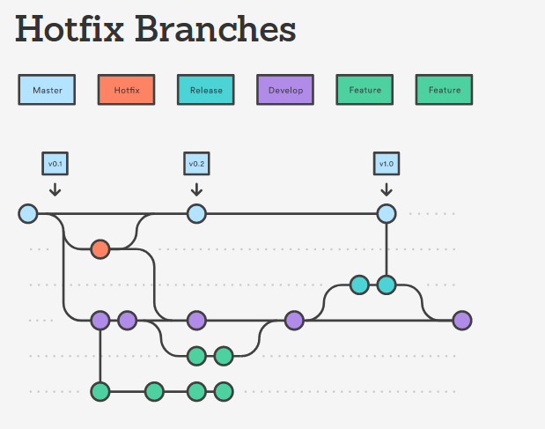
Full workflow

Slide 10
Implement a feature
Start on the main branch
git checkout frc2998_2022
Create a feature branch. Name it something unique
git checkout -b my-feature
Make changes…

Slide 11
Stage files
Show status
git status
Stage changes
git add <files>
(Use the -u flag to add all tracked files, and the -A or --all flag to add all modified files)
Show status
git status
Note: Git staging tracks changes, not files!

Slide 12
Commit
Make a commit:
git commit
or
git commit -m ’Commit message’
View the commit
git log
View the difference between your feature branch and the base branch
git diff frc2998_2022

Slide 13
Work
Make more changes
Commit again
git log
git log --graph
git log --pretty=oneline

Slide 14
Push
Push changes to the server
git push -u origin my-feature
(-u, aka --set-upstream, creates a tracking reference so that a future git push or git pull doesn’t require the branch specifier)
See new branches on github
github

Slide 15
Code review
Examine someone else’s branch (person to your left)
git fetch
git checkout their-feature
Find the differences to the base branch (i.e. code review)
git diff frc2998_2022
Switch back to your own work
git checkout my-feature

Slide 16
Get updates
Ensure you are on your feature branch
git checkout my-feature
Get updated information from the server
git fetch
Merge the latest updates from the base branch
git merge origin/frc2998_2022
If there are conflicts, resolve them:
git mergetool
(Or manually resolve the conflict markers)
Shortcut for fetch + merge:
git pull origin frc2998_2022

Slide 17
Solve an issue
Ok, your work is ready to be included in the main branch. It’s been reviewed, it builds, and it passes the tests.
Let’s assume you have the authority to do a merge to frc2998_2022.
Ensure you are on the main development branch
git checkout frc2998_2022
Get updated information from the server
git fetch origin
Merge the feature branch into the main branch
git merge --no-ff origin/my-feature
(--no-ff means no fast-forward; that is, never pretend that a trivial branch is not a branch)
If there are conflicts, resolve them:
git mergetool

Slide 18
Stashing
You have changes in your local repo, but you don’t want to commit yet
You need to check out another revision (maybe to review someone else’s branch)
git stash save <name>
git stash list
git stash pop

Slide 19
Ignoring files
You have files in the repo that you never want tracked
Add them to .gitignore in the root of the repo
Careful --
.gitignore:
motherboard/bin
motherboard/lib
lcd_testA
...

Slide 20
Github
https://github.com/pgyoung63/frc2998_2022.git

Slide 21
Github Features
View branches
View commits/diffs
View graph

Slide 22
Merge requests
When you push a new feature branch, you can turn it into a merge request.
Github
A merge request is just a way of tracking/sharing a feature branch in Github
Users can comment for code review
Continuous integration (automated build/test) results are displayed
Any merge conflicts are displayed
Project maintainer can perform the merge directly from Github if desired

Slide 23
Resources
git help
git help <subcommand>
Live demo
https://try.github.io
15 minutes or less
More in-depth: http://gitimmersion.com/
https://www.atlassian.com/git/tutorials
More in-depth discussion of branching strategy: http://nvie.com/posts/a-successful-git-branching-model/

Slide 24
Potential Pitfalls
localized_text.cc
CJK font generation (talk to Pierre)
Keeping or removing simulation machine STLs
Removing simulation world STLs (We are definitely doing this)
https://rtyley.github.io/bfg-repo-cleaner/
Rename old authors and add valid emails? https://help.github.com/articles/changing-author-info/
Github
Split simulator and motherboard folders (git filter-branch)

